Slide 1

AdventureWorks Dashboard

Slide 2
Agenda
Project Description
Data Integration “Using SSIS”
Data Reporting “Using PowerBI”
Control Flow
Data Flow
Data Modeling
Dashboard Demo 1

Slide 3
Project Description
Adventure Works Cycles is a multinational company for bikes manufacturing, the company continues to grow.
They demand an End-To-End Business Intelligence Solution to track and analyze their sales for a better decision-making.

Slide 4
Data Integration

Slide 5
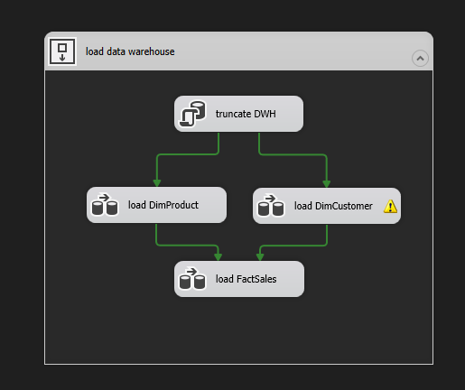
Control Flow

Slide 6
Data Flow
Fact Sales
Dimension Product
Dimension Customer

Slide 7
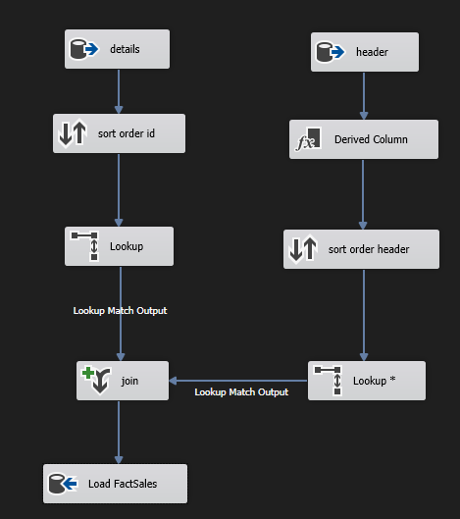
Fact Sales

Slide 8
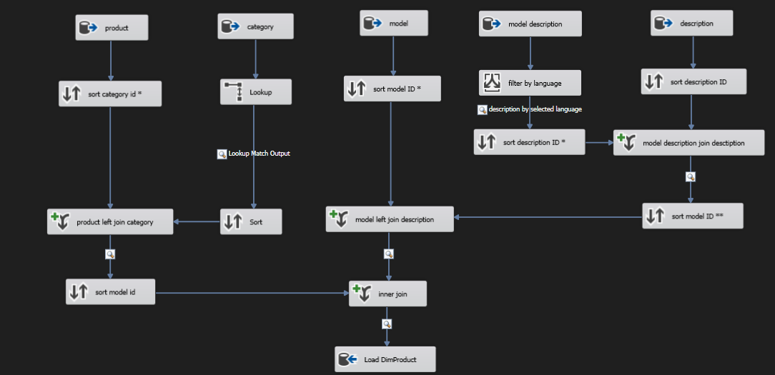
Dimension Product

Slide 9
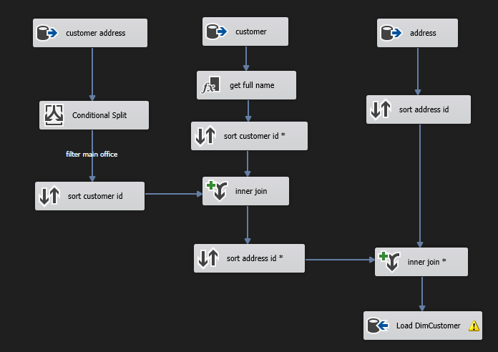
Dimension Customer

Slide 10
Data Reporting

Slide 11
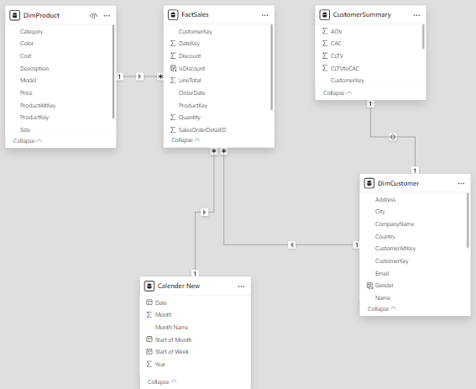
Data Modeling

Slide 12

Demo 1

Slide 13
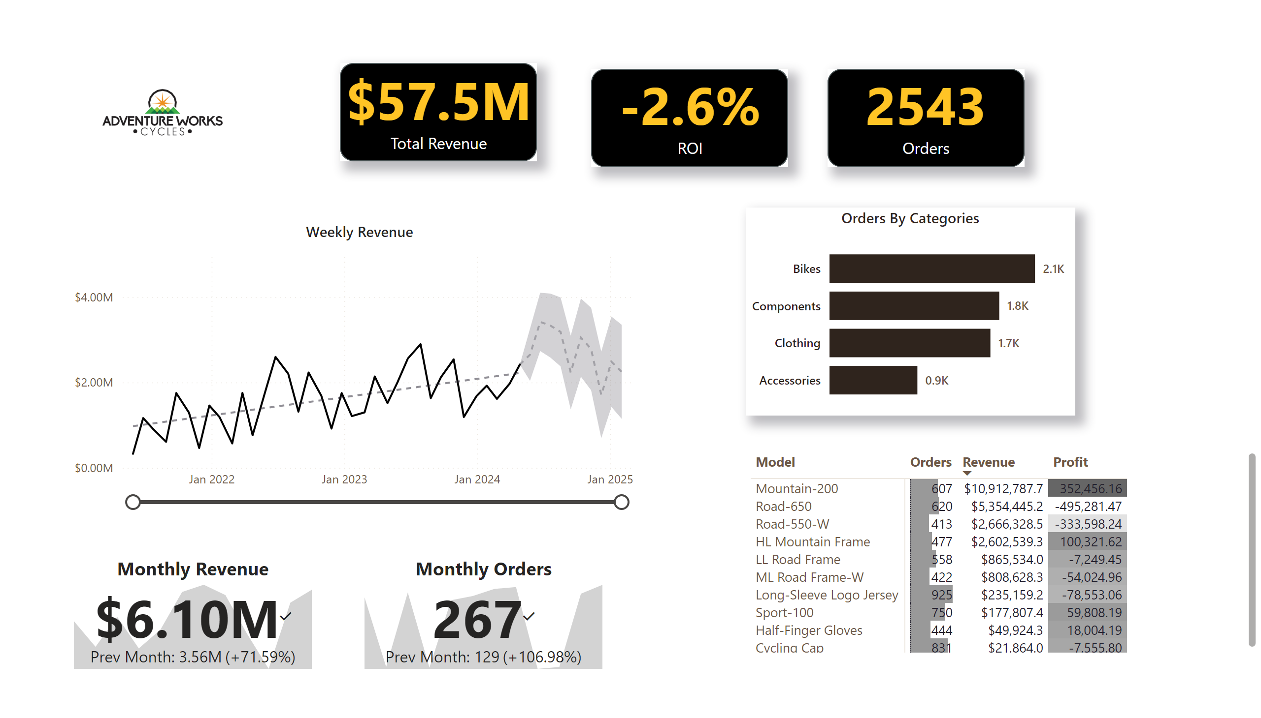
Exective Summary
Notes:
image
No alt text provided
shape
No alt text provided
shape
No alt text provided
card
No alt text provided
card
No alt text provided
Weekly Revenue
No alt text provided
Monthly Revenue
No alt text provided
Monthly Orders
No alt text provided
Orders By Categories
No alt text provided
pivotTable
No alt text provided
shape
No alt text provided
card
No alt text provided

Slide 14
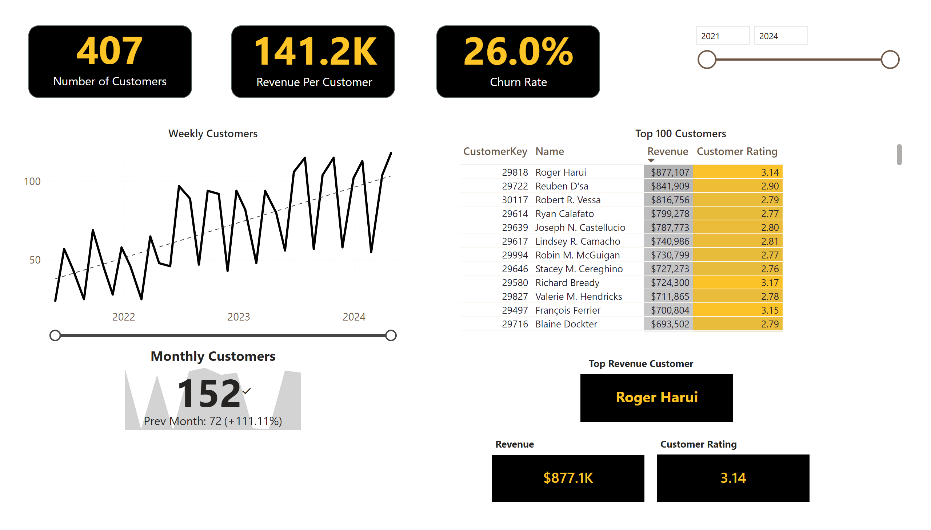
Customer
Notes:
shape
No alt text provided
card
No alt text provided
shape
No alt text provided
card
No alt text provided
Weekly Customers
No alt text provided
shape
No alt text provided
card
No alt text provided
Top 100 Customers
No alt text provided
Monthly Customers
No alt text provided
card
No alt text provided
card
No alt text provided
textbox
No alt text provided
textbox
No alt text provided
textbox
No alt text provided
slicer
No alt text provided
card
No alt text provided

Slide 15
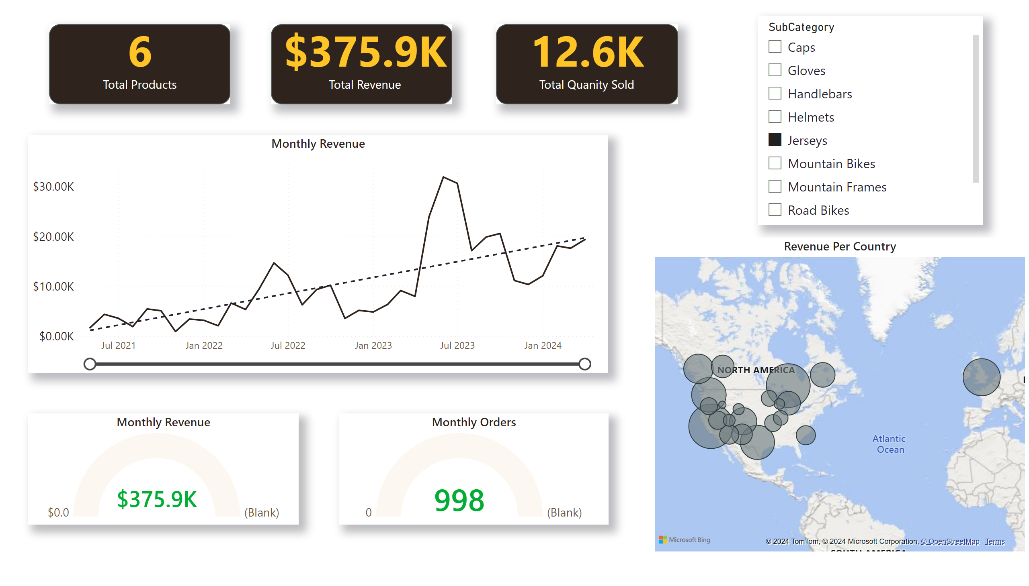
Product
Notes:
slicer
No alt text provided
shape
No alt text provided
card
No alt text provided
shape
No alt text provided
card
No alt text provided
shape
No alt text provided
card
No alt text provided
Monthly Revenue
No alt text provided
Monthly Revenue
No alt text provided
Monthly Orders
No alt text provided
Revenue Per Country
No alt text provided

Slide 16
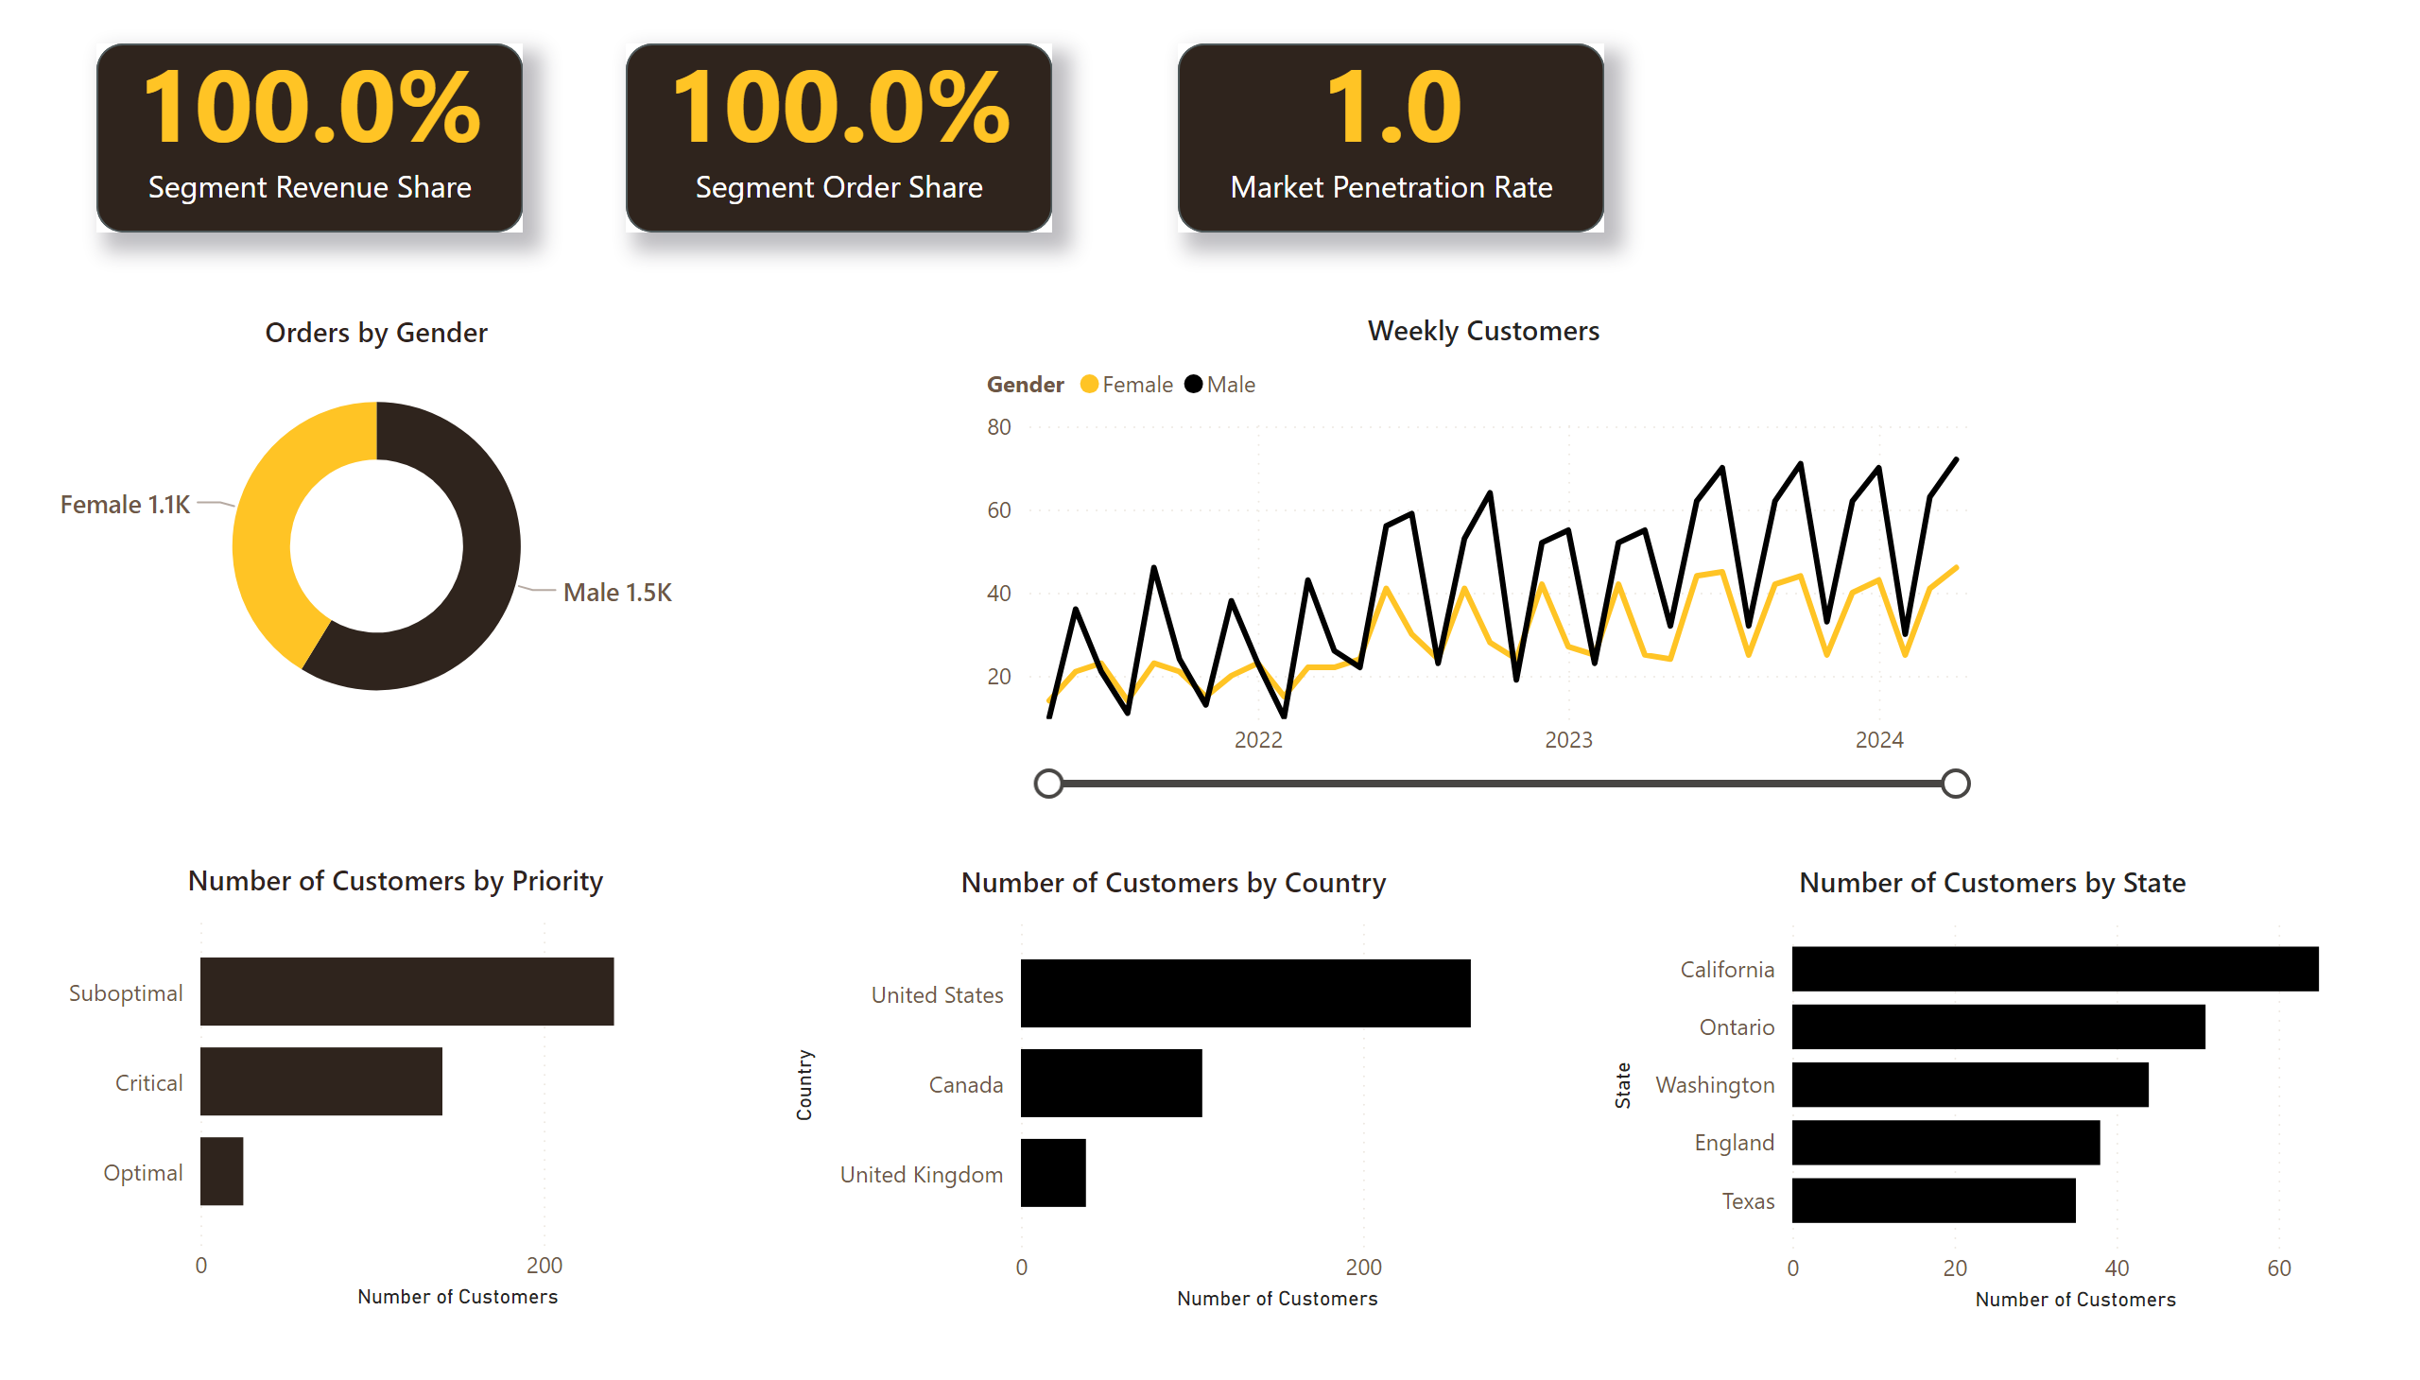
Customer Segmentation
Notes:
Orders by Gender
No alt text provided
Weekly Customers
No alt text provided
shape
No alt text provided
card
No alt text provided
clusteredBarChart
No alt text provided
clusteredBarChart
No alt text provided
clusteredBarChart
No alt text provided
shape
No alt text provided
shape
No alt text provided
card
No alt text provided
card
No alt text provided

Slide 17
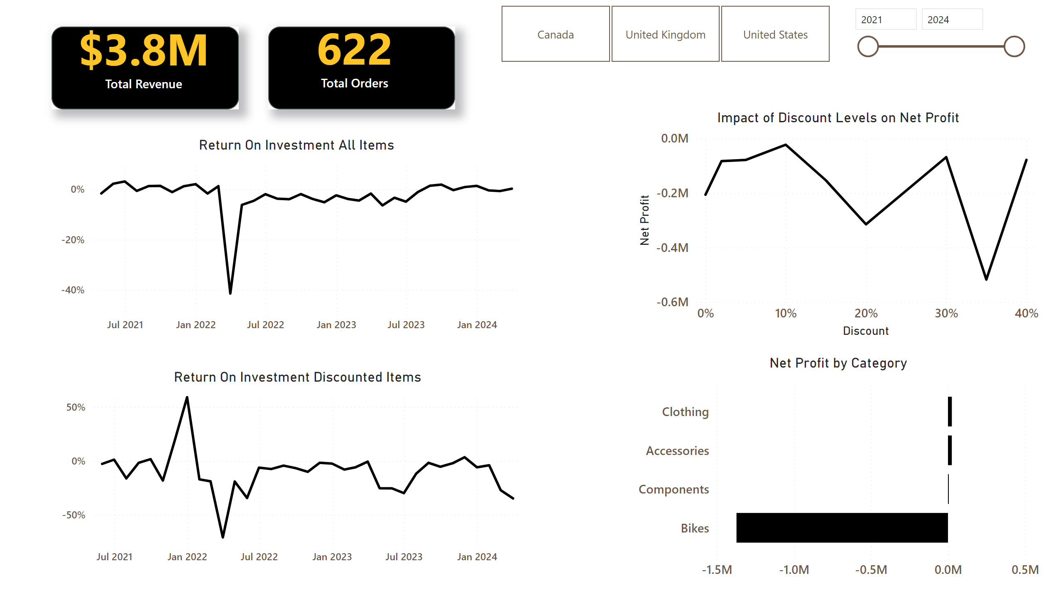
Discount Campain
Notes:
shape
No alt text provided
card
No alt text provided
Return On Investment Discounted Items
No alt text provided
shape
No alt text provided
card
No alt text provided
slicer
No alt text provided
Impact of Discount Levels on Net Profit
No alt text provided
slicer
No alt text provided
clusteredBarChart
No alt text provided
Return On Investment All Items
No alt text provided

